Slide 1
Artificial Intelligence
Chapter 16
Resolution in the Predicate Calculus
Biointelligence Lab
School of Computer Sci. & Eng.
Seoul National University

Slide 2
Outline
Unification
Predicate-Calculus Resolution
Completeness and Soundness
Converting Arbitrary wffs to Clause Form
Using Resolution to Prove Theorems
Answer Extraction
The Equality Predicate
Additional Readings and Discussion
(c) 2000-2002 SNU CSE Biointelligence Lab

Slide 3




16.1 Unification
Abbreviating wffs of the form by
, where are literals that might contain occurrences of the variables
Simply dropping the universal quantifiers and assuming universal quantification of any variables in the
Clauses: WFFs in the abbreviated form
If two clauses have matching but complementary literals, it is possible to resolve them
  Example: ,
(c) 2000-2002 SNU CSE Biointelligence Lab

Slide 4
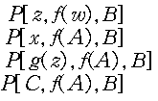
16.1 Unification (Cont’d)
Unification: A process that computes the appropriate substitution
Substitution instance of an expression is obtained by substituting terms for variables in that expression.
  Four substitution instances of are
  The first instance is called an alphabetic variant.
  The last of the four different variables is called a ground instance (A ground term is a term that contains no variables).
(c) 2000-2002 SNU CSE Biointelligence Lab

Slide 5

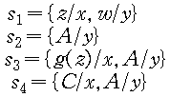
16.1 Unification (Cont’d)
Any substitution can be represented by a set of ordered pairs
  The pair means that term is substituted for every occurrence of the variable throughout the scope of the substitution.
  No variables can be replaced by a tern containing that same variable.
  The substitutions used earlier in obtaining the four instances of
  ws denotes a substitution instance of an expression w, using a substitution s. Thus,
  The composition s1 and s2 is denoted by s1s2, which is that substitution obtained by first applying s2 to the terms of s1 and then adding any pairs of s2 having variables not occurring among the variables of s1. Thus,
(c) 2000-2002 SNU CSE Biointelligence Lab

Slide 6


16.1 Unification (Cont’d)
  Let w be P(x,y), s1 be {f(y)/x}, and s2 be {A/y} then, and
  Substitutions are not, in general, commutative
Unifiable: a set of expressions is unifiable if there exists a substitution s such that
  unifies , to yield
(c) 2000-2002 SNU CSE Biointelligence Lab

Slide 7
16.1 Unification (Cont’d)
MGU (Most general (or simplest) unifier) has the property that if s is any unifier of yielding , then there exists a substitution such that . Furthermore, the common instance produced by a most general unifier is unique except for alphabetic variants.
UNIFY
  Can find the most general unifier of a finite set of unifiable expressions and that report failure when the set cannot be unified.
  Works on a set of list-structured expressions in which each literal and each term is written as a list.
  Basic to UNIFY is the idea of a disagreement set. The disagreement set of a nonempty set W of expressions is obtained by locating the first symbol at which not all the expressions in W have exactly the same symbol, and then extracting from each expression in W the subexpression that begins with the symbol occupying that position.
(c) 2000-2002 SNU CSE Biointelligence Lab

Slide 8
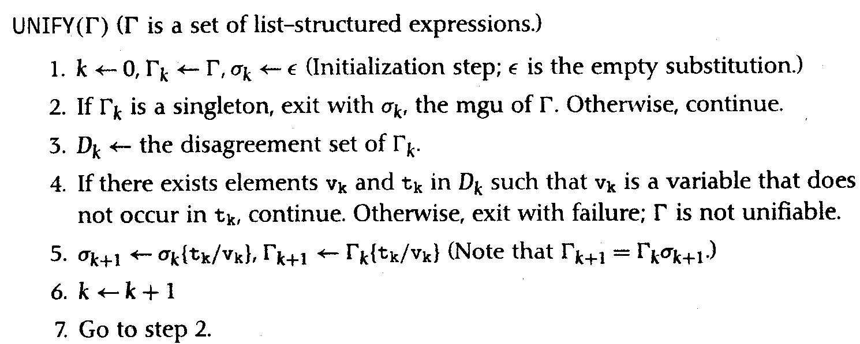
16.1 Unification (Cont’d)
(c) 2000-2002 SNU CSE Biointelligence Lab

Slide 9

16.2 Predicate-Calculus Resolution
are two clauses. Atom in and a literal in such that and have a most general unifier, , then these two clauses have a resolvent, . The resolvent is obtained by applying the substitution to the union of and , leaving out the complementary literals.
Examples:
(c) 2000-2002 SNU CSE Biointelligence Lab

Slide 10
16.3 Completeness and Soundness
Predicate-calculus resolution is sound
  If ρ is the resolvent of two clauses φ and ψ, then {φ, ψ}|= ρ
Completeness of resolution
  It is impossible to infer by resolution alone all the formulas that are logically entailed by a given set.
  In propositional resolution, this difficulty is surmounted by using resolution refutation.
(c) 2000-2002 SNU CSE Biointelligence Lab

Slide 11
16.4 Converting Arbitrary wffs to Clause Form
1. Eliminate implication signs.
2. Reduce scopes of negation signs.
3. Standardize variables
  Since variables within the scopes of quantifiers are like “dummy variables”, they can be renamed so that each quantifier has its own variable symbol.
4. Eliminate existential quantifiers.
(c) 2000-2002 SNU CSE Biointelligence Lab

Slide 12

16.4 Converting Arbitrary wffs to Clause Form (Cont’d)
  Skolem function, Skolemization:
  Replace each occurrence of its existentially quantified variable by a Skolem function whose arguments are those universally quantified variables
  Function symbols used in Skolem functions must be “new”.
(c) 2000-2002 SNU CSE Biointelligence Lab

Slide 13
16.4 Converting Arbitrary wffs to Clause Form (Cont’d)
  Skolem function of no arguments
  Skolem form: To eliminate all of the existentially quantified variables from a wff, the proceding procedure on each subformula is used in turn. Eliminating the existential quantifiers from a set of wffs produces what is called the Skolem form of the set of formulas.
  The skolem form of a wff is not equivalent to the original wff. . What is true is that a set of formulas,  is satisfiable if and only if the Skolem form of  is. Or more usefully for purpose of resolution refutations,  is unsatisfiable if and only if the Skolem form of  is unsatifiable.
(c) 2000-2002 SNU CSE Biointelligence Lab

Slide 14
16.4 Converting Arbitrary wffs to Clause Form (Cont’d)
5. Convert to prenex form
  At this stage, there are no remaining existential quantifiers, and each universal quantifier has its own variable symbol.
  A wff in prenex form consists of a string of quantifiers called a prefix followed by a quantifier-free formula called a matrix. The prenex form fof the example wff marked with an * earlier is
6. Put the matrix in conjunctive normal form
  When the matrix of the preceding example wff is put in conjunctive normal form, it became
(c) 2000-2002 SNU CSE Biointelligence Lab

Slide 15

16.4 Converting Arbitrary wffs to Clause Form (Cont’d)
7. Eliminate universal quantifiers
  Assume that all variables in the matrix are universally quantified.
8. Eliminate ∧ symbols
  The explicit occurrence of ∧ symbols may be eliminated by replacing expressions of the form with the set of wffs .
(c) 2000-2002 SNU CSE Biointelligence Lab

Slide 16

16.4 Converting Arbitrary wffs to Clause Form (Cont’d)
9. Rename variables
  Variable symbols may be renamed so that no variable symbol appears in more than one clause .
(c) 2000-2002 SNU CSE Biointelligence Lab

Slide 17
16.5 Using Resolution to Prove Theorem
To prove wff ω from Δ, proceed just as in the propositional calculus.
  1. Negate ω,
  2. Convert this negation to clause form, and
  3. Add it to the clause form of Δ.
  4. Then apply resolution until the empty clause is deduced.
(c) 2000-2002 SNU CSE Biointelligence Lab

Slide 18
16.5 Using Resolution to Prove Theorem (Cont’d)
Problem: the package delivery robot. Suppose this robot knows that all of the packages in room 27 are smaller than any of the ones in room 28.
  1.
  2.
  Suppose that the robot knows the following:
  3. P(A)
  4. P(B)
  5. I(A,27)∨I(A,28) // package A is either in room 27 or in room 28 (but not which)
  6. I(B,27) // package B is in room 27
  7. ¬S(B,A) // package B is not smaller than package A.
(c) 2000-2002 SNU CSE Biointelligence Lab

Slide 19
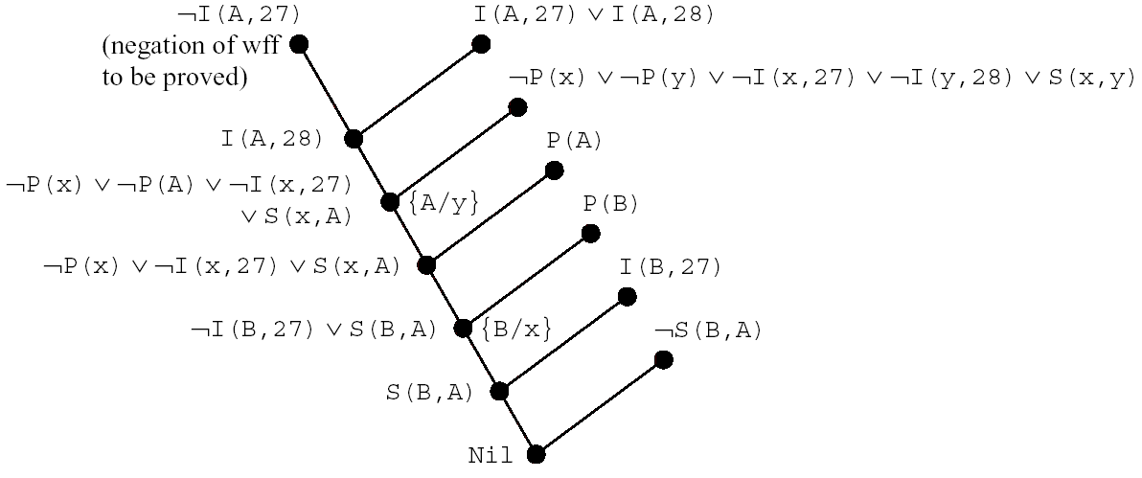
16.5 Using Resolution to Prove Theorem (Cont’d)
Figure 16.1 A Resolution Refutation
(c) 2000-2002 SNU CSE Biointelligence Lab

Slide 20
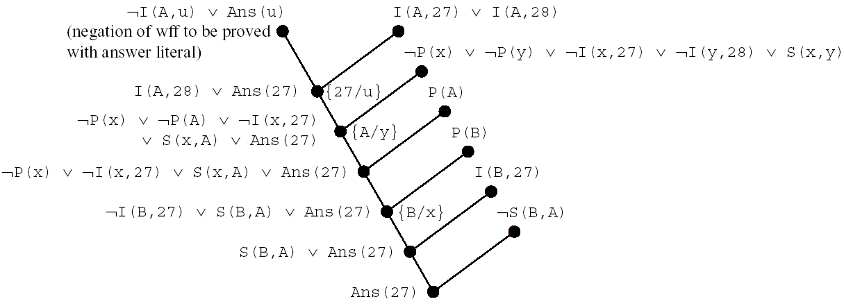
16.6 Answer Extraction
(c) 2000-2002 SNU CSE Biointelligence Lab

Slide 21
16.7 The Equality Predicate
The relation constants used in the formulas in a knowledge base usually have intended meanings, but these relations are circumscribed only by the set of models of the knowledge base and not at all by the particular symbols used for relation constants. The result of resolution refutations will be consistent with intended meanings only if the knowledge base suitably constrains the actual relations.
Equality relation: Equals(A,B) or A=B
  Reflexive (∀x)Equals(x,x)
  Symmetric (∀x, y)[Equals(x, y)⊃Equals(y, x)]
  Transitive (∀ x, y, z)[Equals(x, y) ∧ Equals(y, z) ⊃ Equals(x, z)]
(c) 2000-2002 SNU CSE Biointelligence Lab

Slide 22
16.7 The Equality Predicate
Paramodulation
  Equality-specific inference rule to be used in combination with resolution in cases where the knowledge base contains the equality predicate .
  γ1, γ2 are two clauses. If and , where τ, α, β are terms, where γ1` are clauses, and where λ(τ) is a literal containing the term τ, and if τ and α have a most general unifier σ, then infer the binary paramodulant of γ1 and γ2: where λσ[(βσ)] denotes the result of replacing a single occurrence of τσ in λσ by βσ.
  Prove P(B) from P(A) and (A=B)
    For a refutation-style proof, we must deduce the empty clause from the clauses ¬P(B), P(A), and (A=B).
    Using paramodulation on the last two clauses, λ(τ) is P(A), τ is A, α is A, and β is B. Since A (in the role of τ) and A (in the role of α) unify trivially without a substitution, the binary paramodulation is P(B), which is the result of replacing an occurrence of τ (that is A) with β (that is B). Resolving this paramodulant with ¬P(B) yields the empty clause.
(c) 2000-2002 SNU CSE Biointelligence Lab

Slide 23
  With a slight extension to the kinds of paramodulants allowed, it can be shown that paramodulation combined with resolution refutation is complete for knowledge bases containing the equality predicate.
  For problem that do not require substituting equals for equals, the power of paramodulation is not needed.
  If an external process is able to return a truth value for an equality predicate, we can replace that predicate by T or F as appropriate. In resolution reputation, clauses containing the literal T can then be eliminated. The literal F in any clause can be eliminated.
  The problem of proving that if a package, say , A, is in a particular room, say, R1, then it cannot be in a different room, say, R2.
    Statements in knowledge base. (∀x, y, u, v)[In(x, u) ∧(u≠v)]⊃¬In(x, v), In(A, R1)
    In attempting to prove ¬In(A, R2). Converting the first formula into clause form yields ¬In(x, u)∨(u=v) ∨ ¬In(x, v)
    The strategy postpones dealing with equality predicates until they contain only ground terms. Resolving the clause with the negation of the wff to be proved yields (R2=V) ∨ ¬In(A, v).
    Resolving the result with the given wff In(A,R1) yields (R2=R1).
    If the knowledge base actually contains the wff ¬(R2=R1), then it produces the empty clause, completing the refutation.
(c) 2000-2002 SNU CSE Biointelligence Lab

Slide 24
16.7 The Equality Predicate (Cont’d)
If the reasoning involves numbers, it might need an unmanageably large set of wffs. Instead of having all wffs explicitly in the knowledge base, it would be better to provide a routine that would be able to evaluate expressions of the form (α=β) for all (ground) α and β.
Several other relations (greater than, less than…) and functions (plus, times, divides,…) could be evaluated directly rather than reasoned about with formulas.
Evaluation of expressions is thus a powerful , efficiency-enhancing tool in automated reasoning systems.
(c) 2000-2002 SNU CSE Biointelligence Lab

Slide 25
Additional Readings and Discussion
Some people find the resolution inference rule nonintuitive and prefer so-called natural-deduction methods. These are called “natural” because inference is performed on sentences more or less “as is” without transformations into canonical forms.
Predicate evaluation is an instance of a more general process called semantic attachment in which data structure and programs are associated with elements of the predicate-calculus language. Attached structures and procedures can then be used to evaluate expressions in the language in a way that corresponds to their intended interpretations.
(c) 2000-2002 SNU CSE Biointelligence Lab

